Slide 1


Robotics Workshop Week 3 Introduction to mechanics
Notes:
Hello everyone, welcome, thanks for coming to the 3rd robotics workshop this year,
(if more people) Looks like there's more of you than last time.
For the past 2 workshops we have looked at electronics and micro controllers, but today we are mixing it up with some mechanics.
So, as usual after my short presentation, you’ll get into groups of 2 – 4 and work through the worksheet while we walk around to help.
Today’s worksheet is slightly different because most tasks don’t have any instructions, instead you have to figure out how to make the final result yourself.

Slide 2
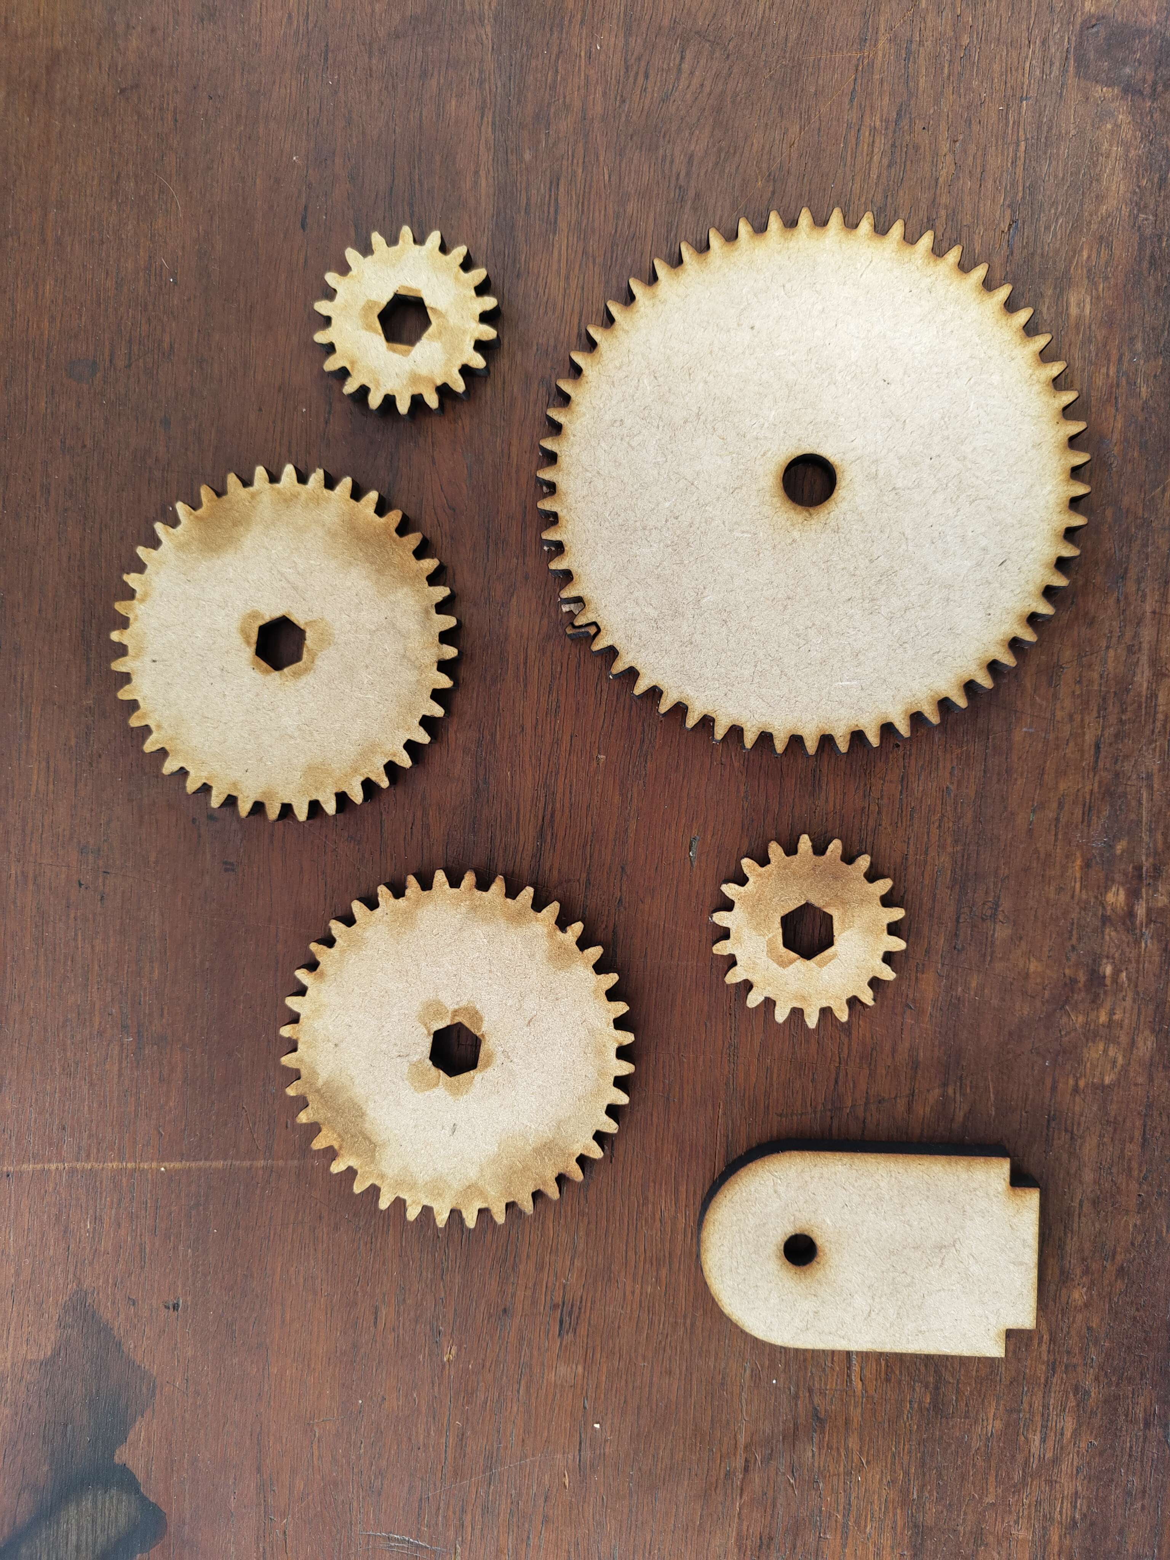
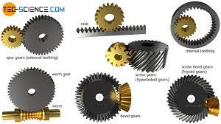
What is a gear?
Notes:
What is a gear?
A gear is usually a circular part with many teeth around its perimeter allowing it to transfer mechanical motion and exchange speed for torque depending on the configuration.
There are many other types of gears, but we will mainly focus on the simple ones on the left.

Slide 3
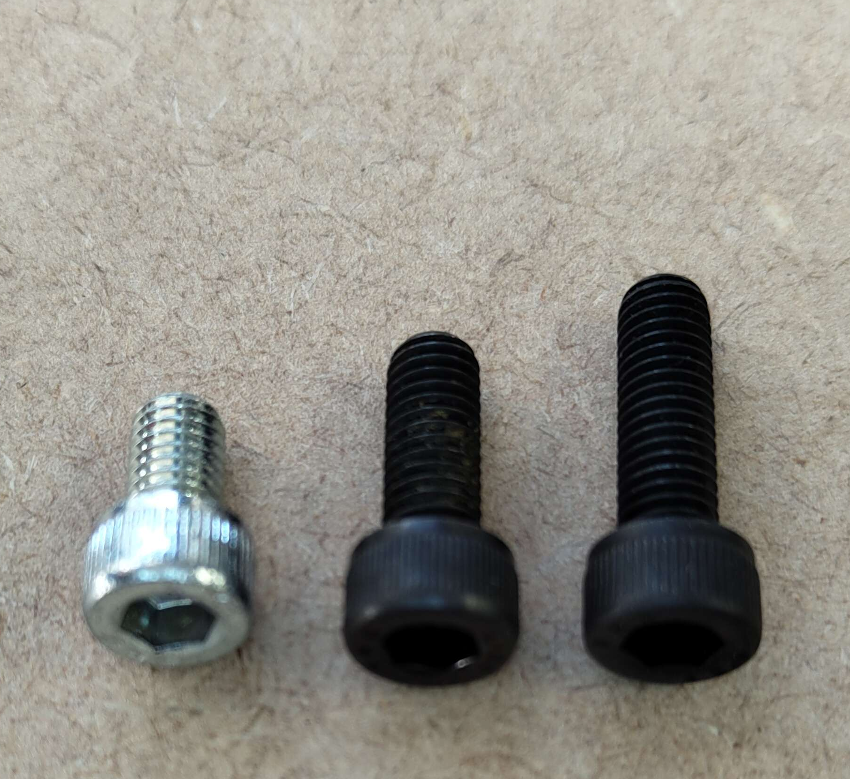
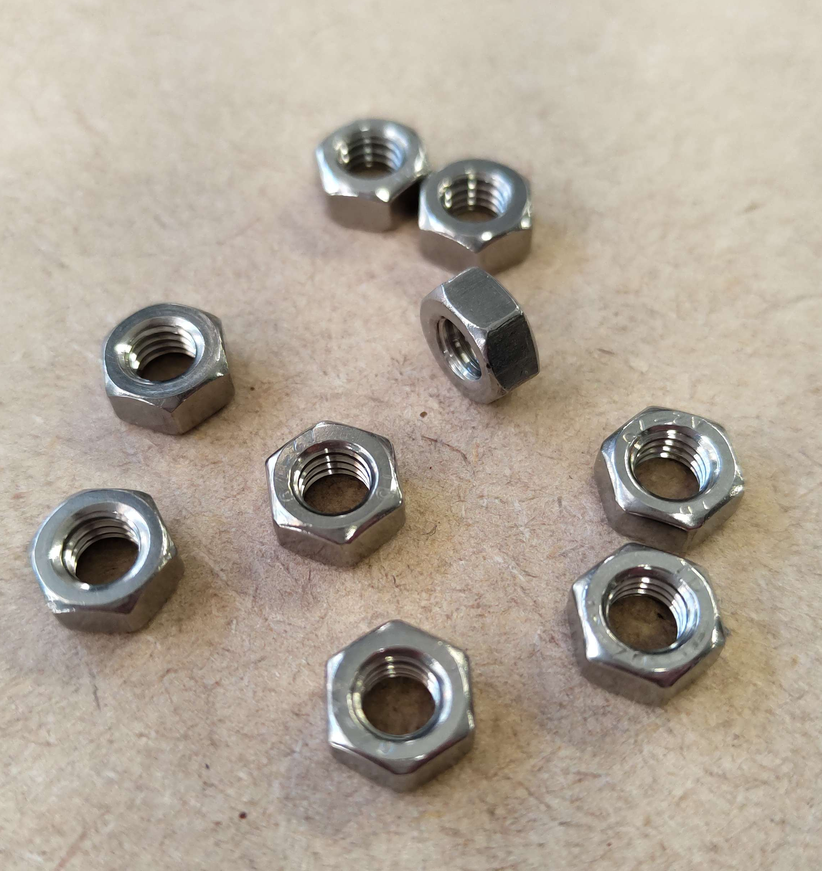
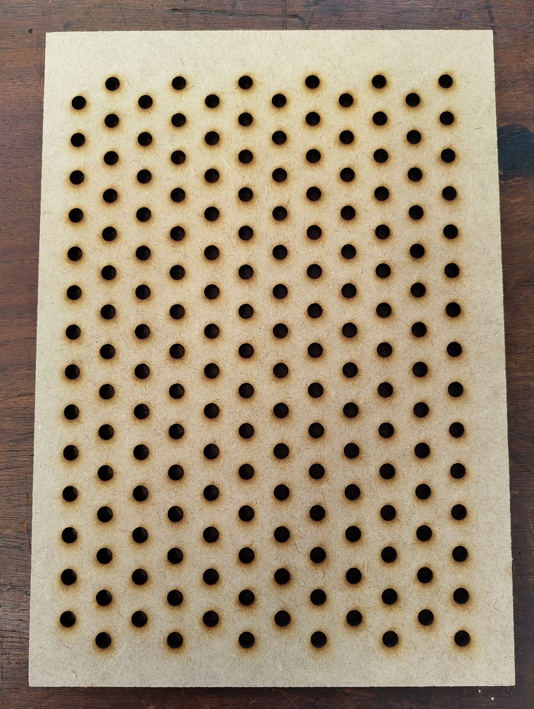
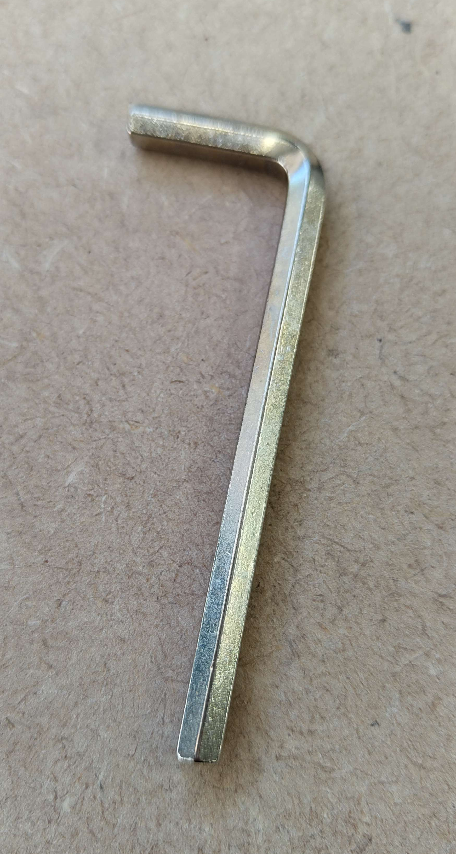
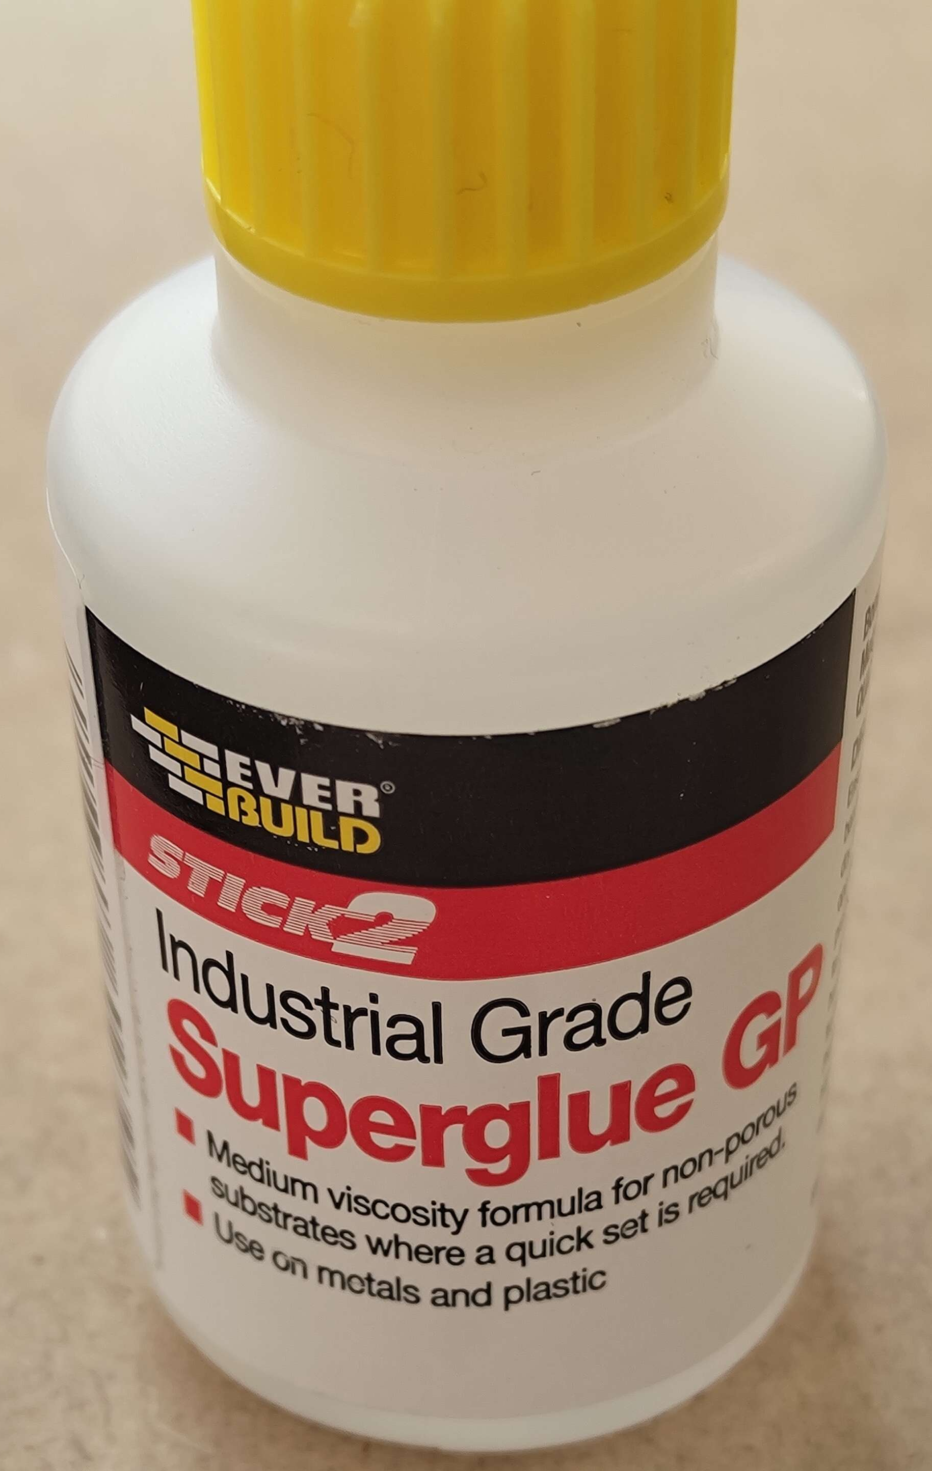
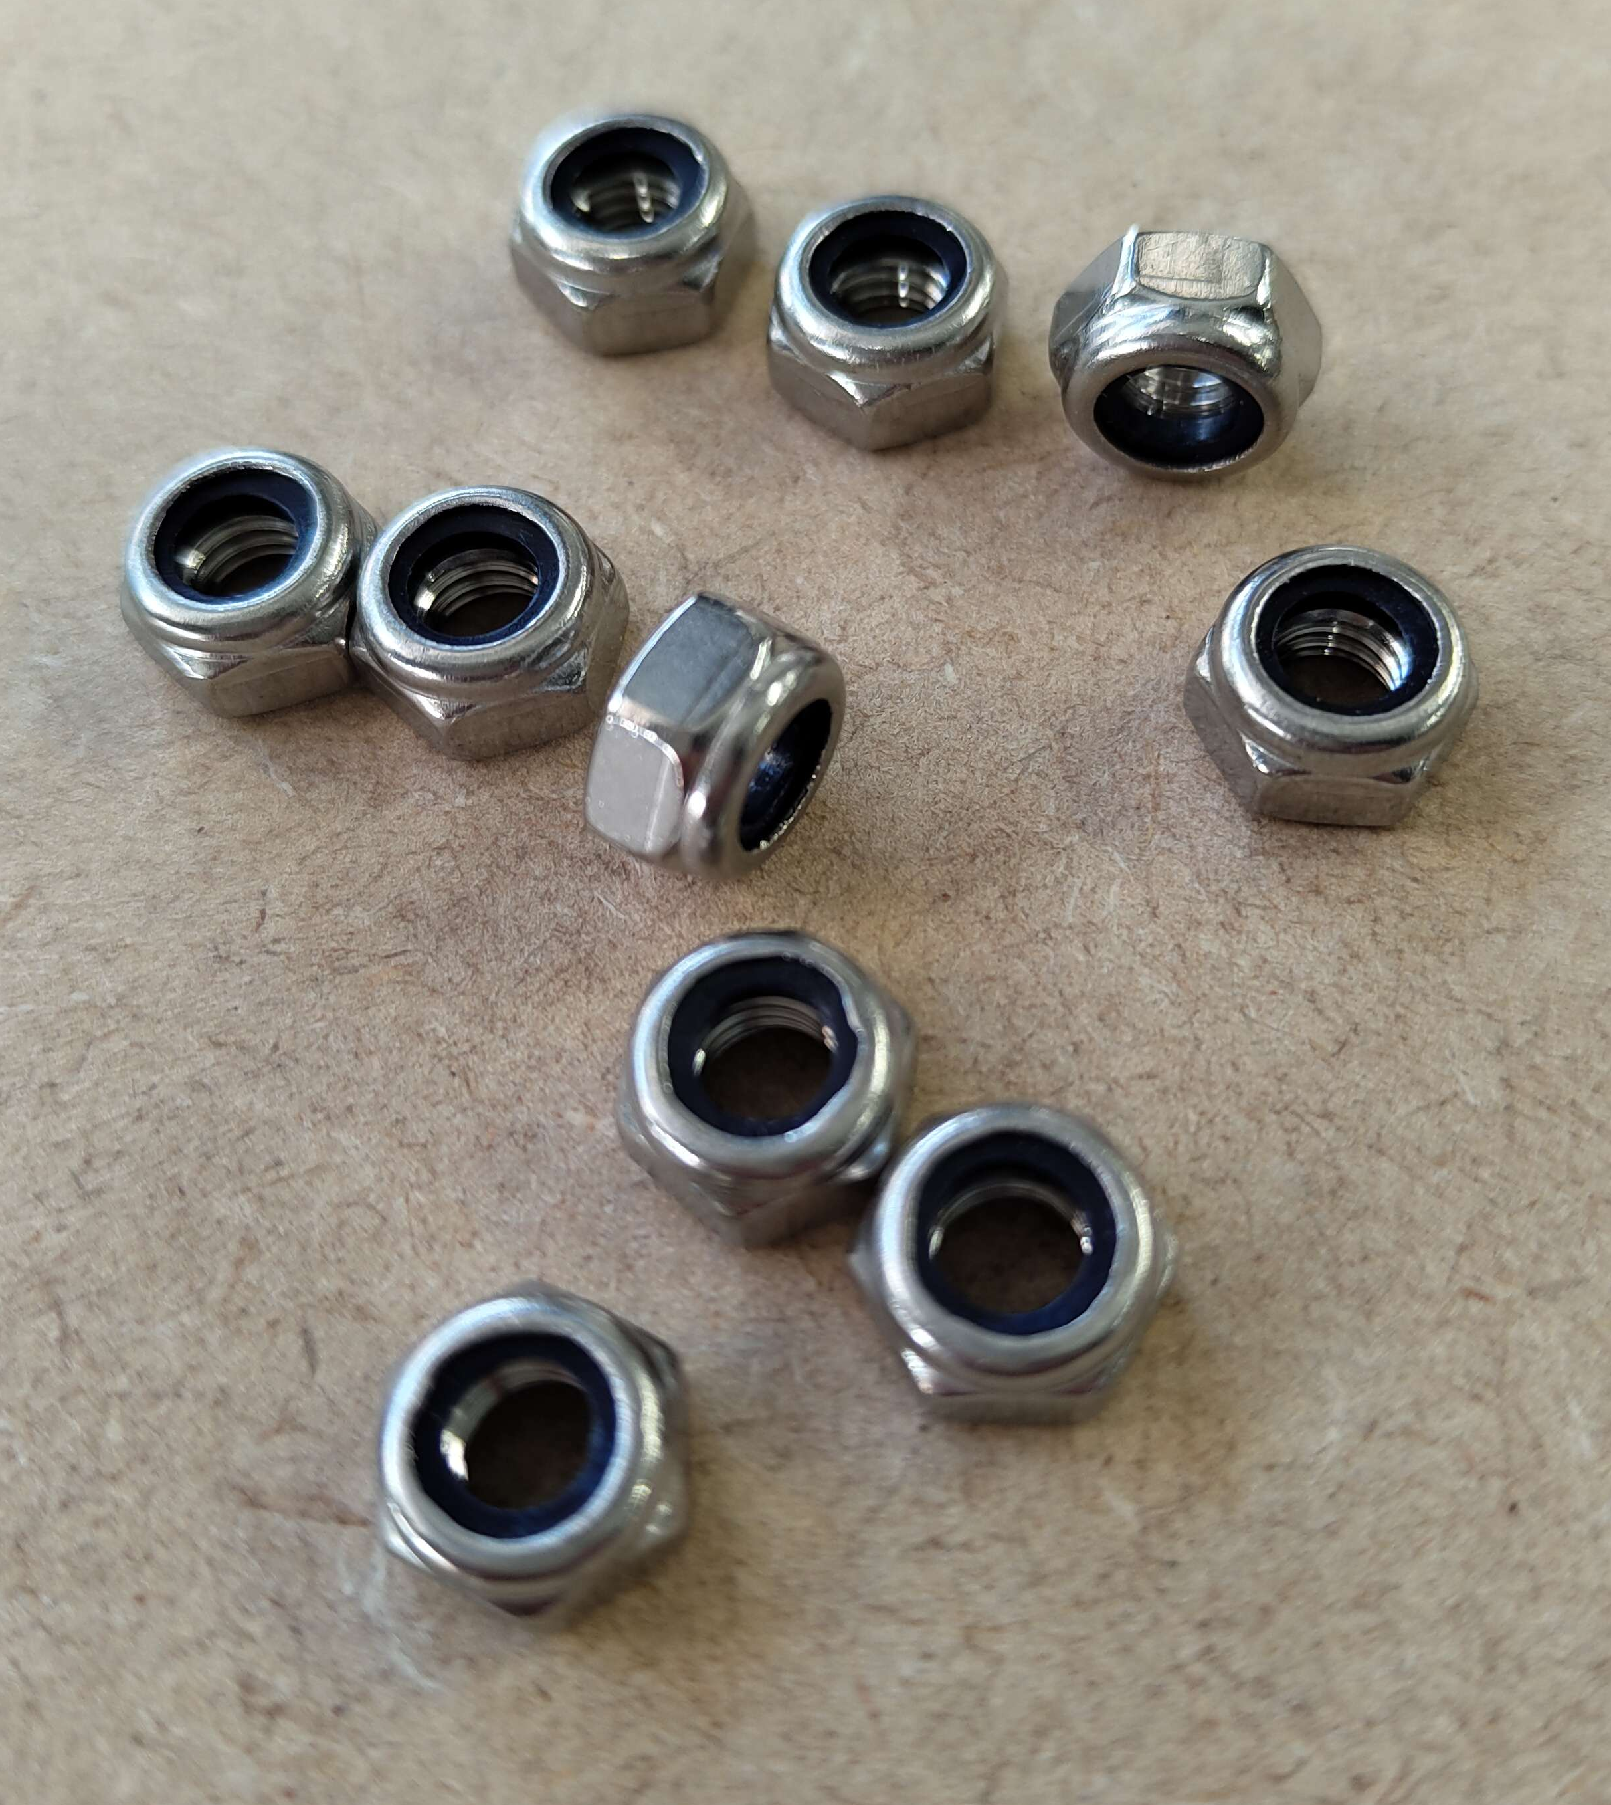
Tools and materials you will use
Bolts
Regular nuts (don’t glue)
Isometric pegboard
Alan keys
Various Gears and brackets
Super glue
Nylon locking nuts
Notes:
So today,
You’ll be playing with gear configurations on a pegboard, which is simply a wooden board with a bunch of holes.
You will mount the gears on the pegboard by adding nuts and bolts to allow the gears to rotate.
In the final task you will do some super-gluing, for those of you who don’t know, superglue is a strong, fast setting adhesive and you'll use it to glue some nuts and bolts inside gears.
Please don’t stick your fingers together and be careful not to stick anything to the table.
And finally try and ensure that what you glue together doesn’t hinder your ability to disassemble what you make, but don’t worry if you accidentally do.

Slide 4
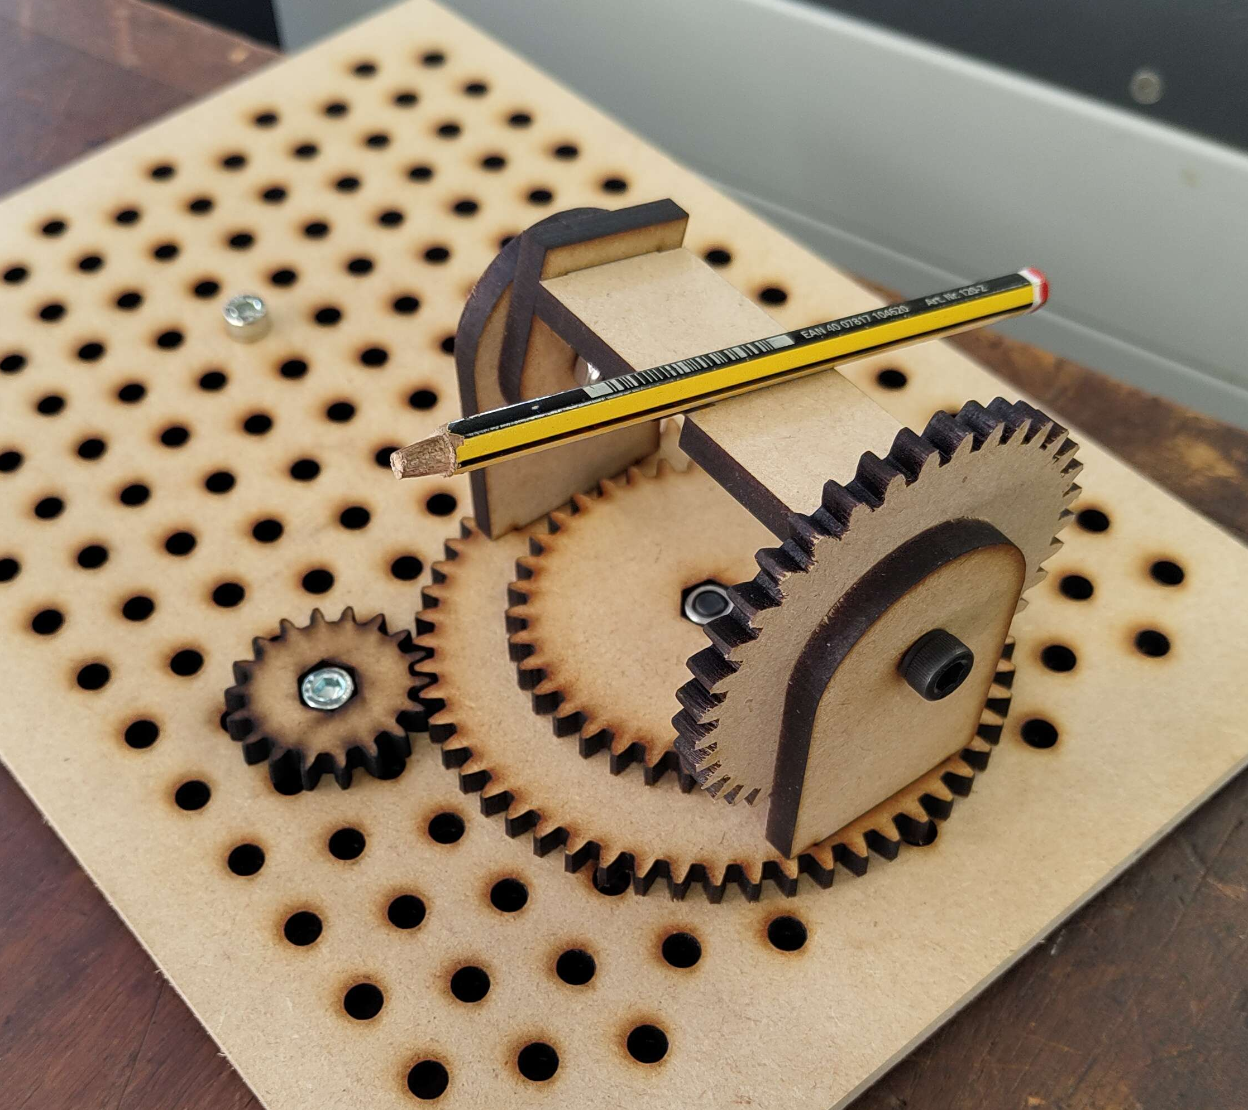
What you’ll be making
Mechanical 360 degree aiming device / turret
Notes:
So, after you’ve completed the first 2 exercises on the worksheet your goal is to create this turret like aiming device, a fully assembled one will be at the front for you to reference.
Some assembly is required because all the parts are freshly laser cut, so lets get started.
Ill be taking some photos today so if anyone doesn’t want to be in a photo please let me know.

